Slide 1
The Yin and Yang of A Doctoral Program – Personal Reflections & Reverse Engineering
2019 IACIS Annual Conference, Oct 2 – 5, Clearwater Beach, FL, USA
Fred Hoffman, Mercyhurst University, fhoffman@mercyhurst.edu
Jay Wang, The MITRE Corporation, cjwang@mitre.org
Alvi Lim, The MITRE Corporation, alim@mitre.org
Jin Kwon, Robert Morris University, jhkst187@mail.rmu.edu

Slide 2
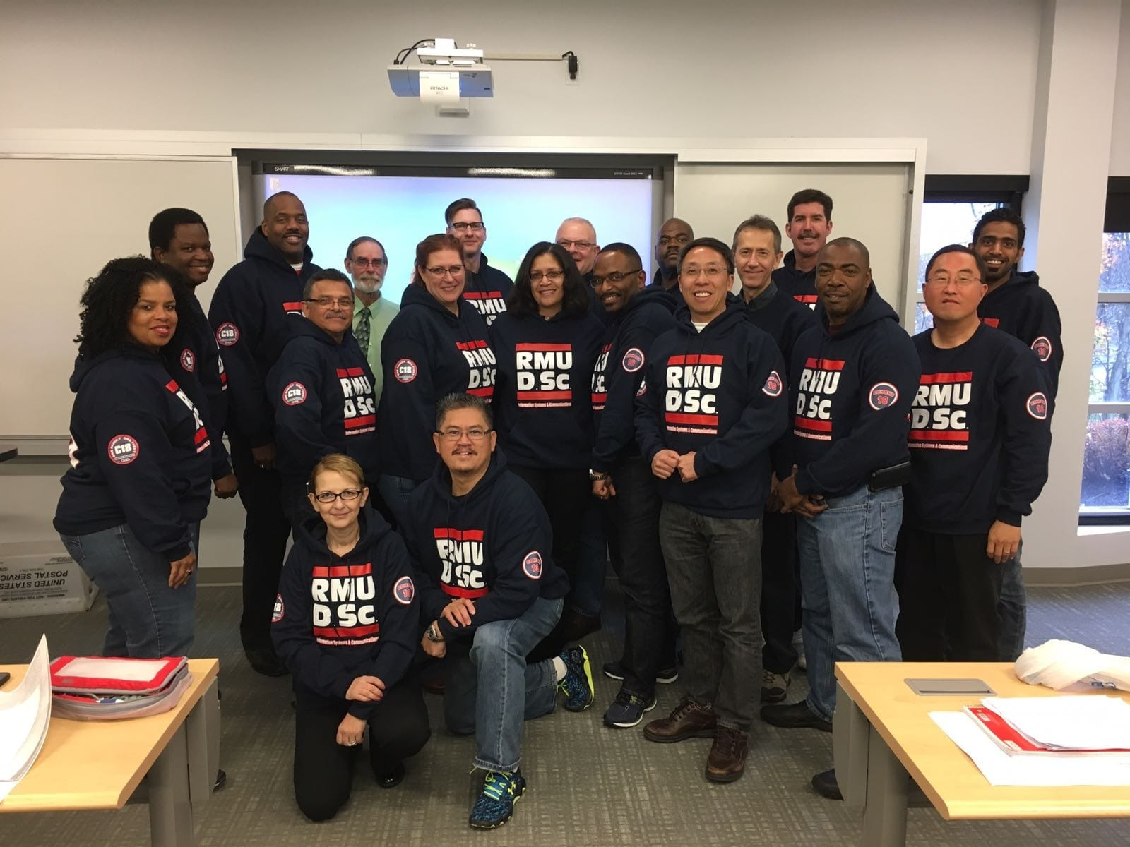
Graduating Class of Cohort 18
Notes:
Founded 1999
Three-year
Executive-format
Cohort-based
In-person

Slide 3

The Yin-Yang Model
Yin 阴
Yang 阳
Feminine
Moon
Night
Water Soft
Intuitive (Pathos)
Muscular
Sun
Day
Mountain
Hard
Logical(Logos)
Key Principle: Yin-Yang Interdependency and Balance
Notes:
Pathos vs Logos

Slide 4
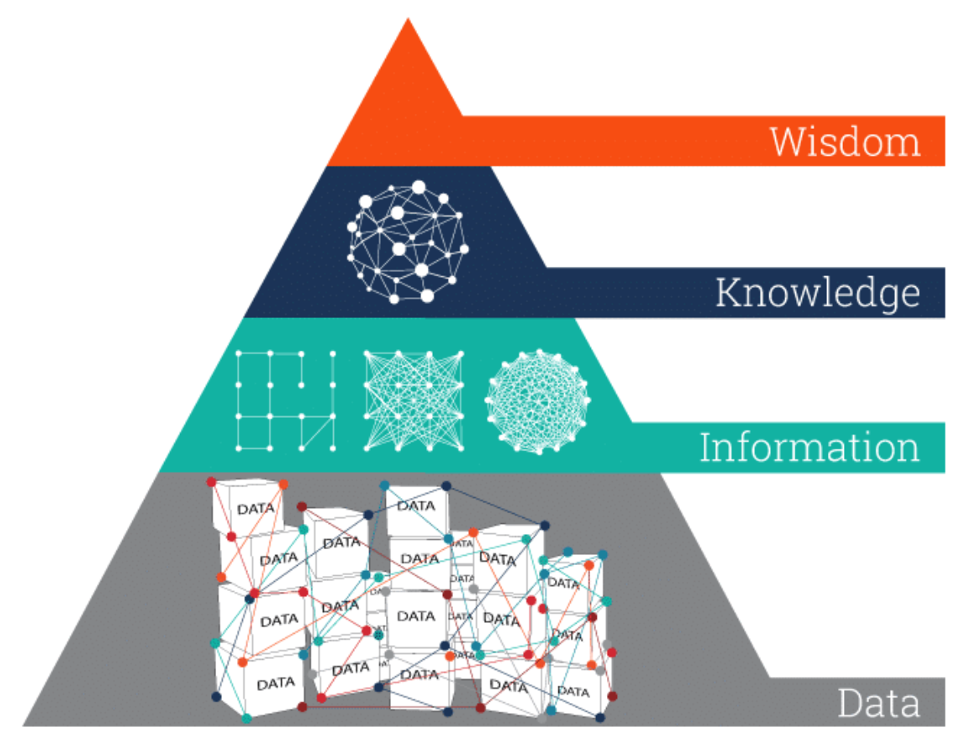
The Wisdom Hierarchy
knows why
knows how
knows what
knows nothing
Image adapted from: https://www.ontotext.com/knowledgehub/fundamentals/dikw-pyramid/

Slide 5
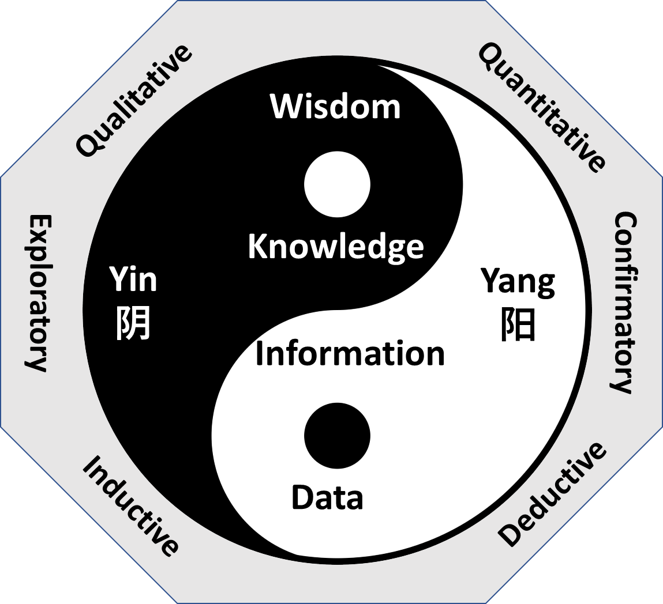
The Yin-Yang Research Model

Slide 6
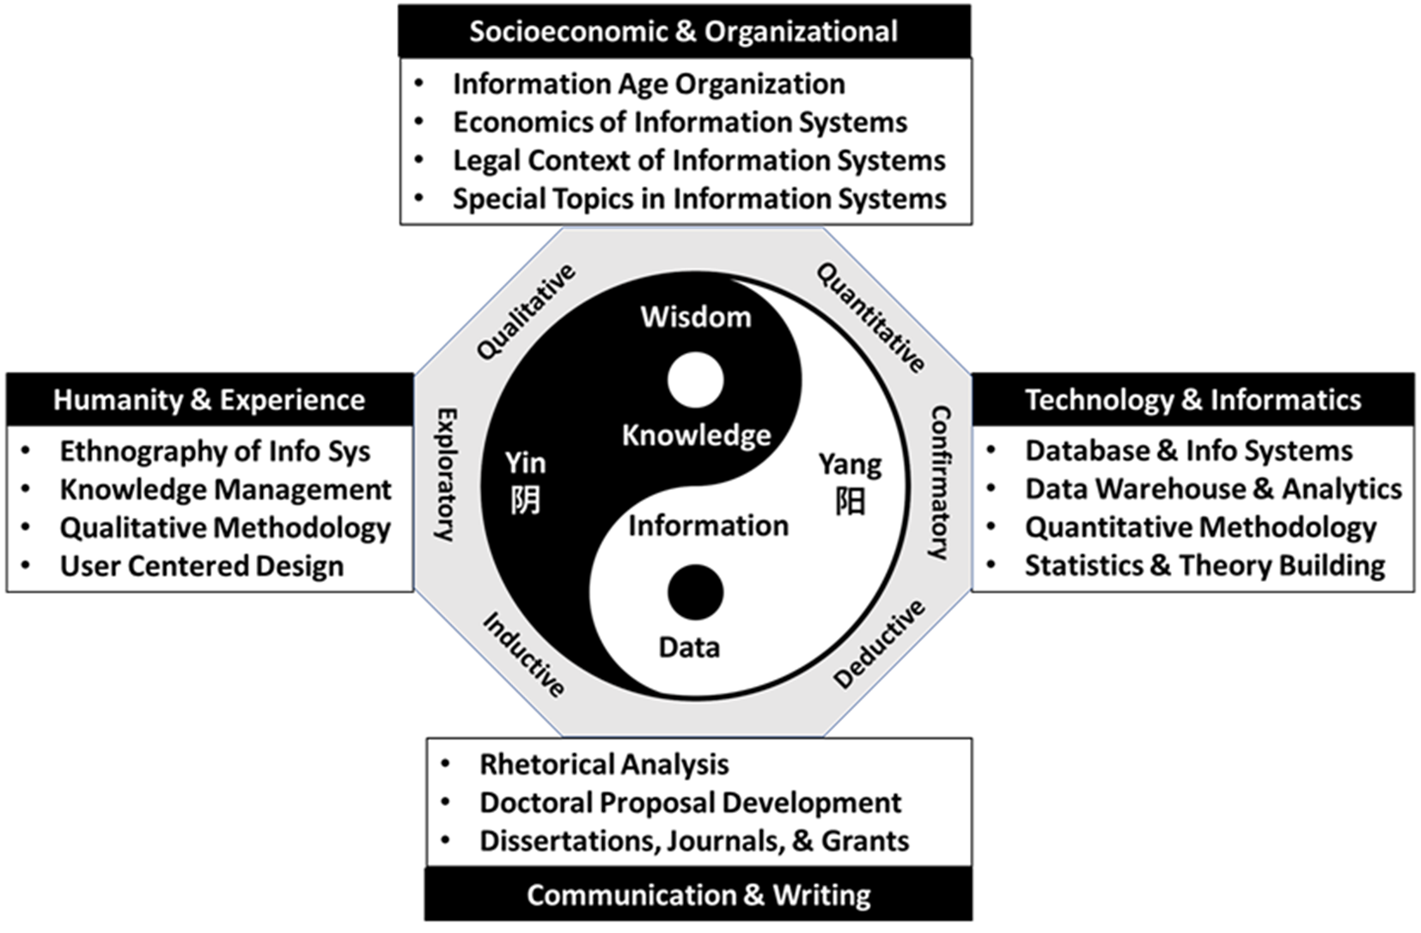
The Four Dimensions of The RMU Doctoral Program

Slide 7
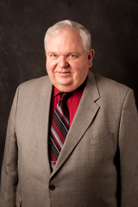
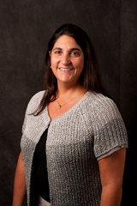
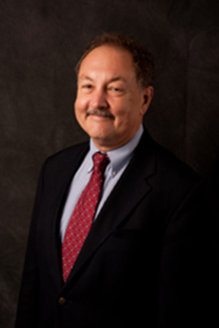
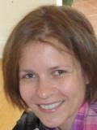
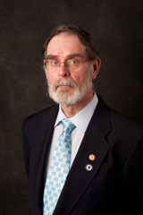
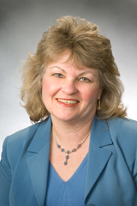
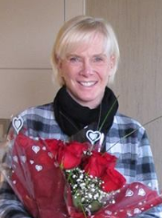
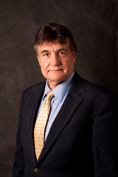
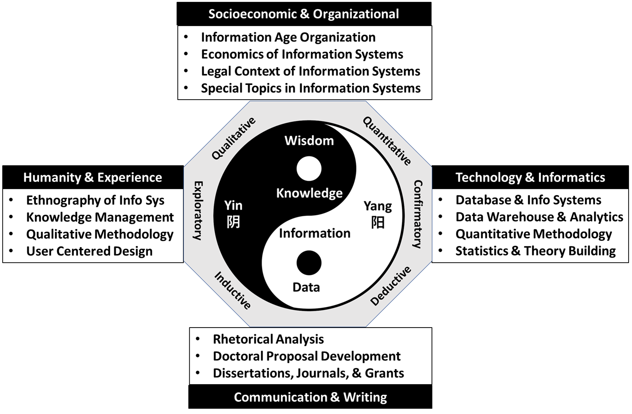
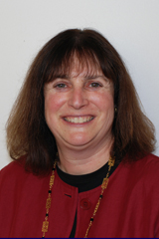

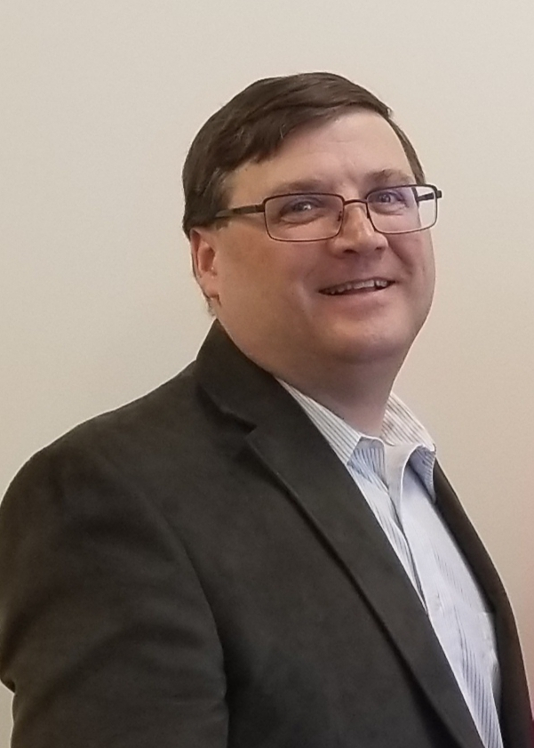
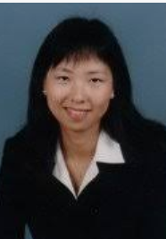
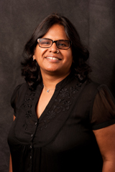
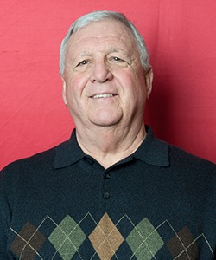
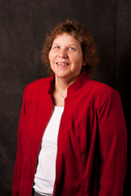
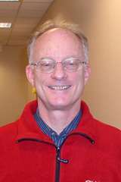
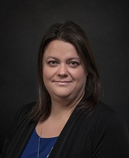
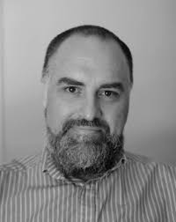


The Yin & Yang of RMU Doctoral Faculty

Slide 8
Thank You!

